Slide 1
Heart Disease Risk Factor study
November 2022

Slide 2
Table of Contents I. Data Overview II. Key findings III. Modeling results IV. Recommendations

Slide 3
Executive summary/audience
Stakeholders – Doctors who are specialized in cardiology and would like to prioritize their ability to accurately identify heart disease in their patients, either those who have it or are at an increased risk
Potential risks include medical malpractice lawsuits along with adverse outcomes for patients.
Cardiovascular diseases (CVDs) are the number 1 cause of death globally, taking an estimated 17.9 million lives each year, which accounts for 31% of all deaths worldwide.
People with cardiovascular disease or who are at high cardiovascular risk (due to the presence of one or more risk factors such as hypertension, diabetes, hyperlipidaemia or already established disease) need early detection and management.

Slide 4
I. Data overview
Combination of different global studies – 918 unique observations
USA - Cleveland/Long Beach/UC Irvine – Data repository
Europe – Hungary/Switzerland
Demographic factors (Age/Sex)
Clinical risk factors (Cholesterol/BP/Blood Sugar)
Cholesterol
BP
Heart related metrics (EKG, exercise angina)
Types of Chest Pain
Resting ECG
Maximum Heart rate
Exercise Angina
Oldpeak
ST_Slope
Heart Disease

Slide 5
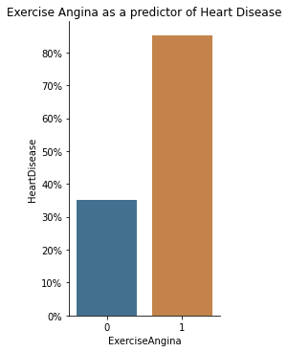
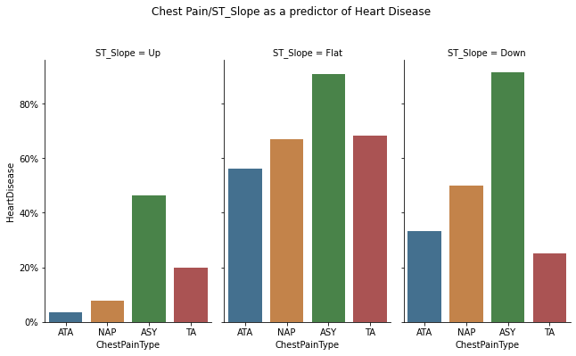
II. Key findings Categorical
Exercise Angina leading indicator of heart disease
Chest pain type of ASY is problematic, even more so when ST_slope is Flat or Down

Slide 6
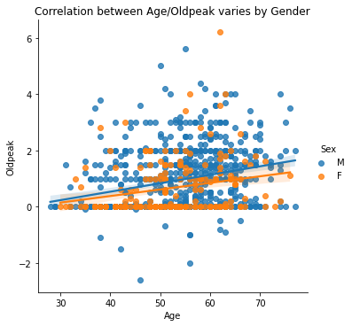
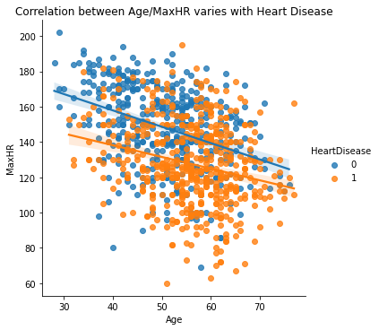
II. Key findings correlation
Linear relationship between certain variables
Oldpeak varies by age and gender
MaxHR varies by age and the presence of heart disease

Slide 7
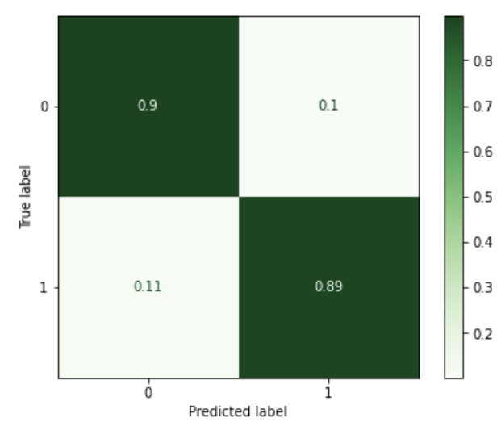
III. Modeling results
Various models used - KNN, Logistic regression, Decision tree, gradient boosting
Optimal model predicts heart disease with 90% accuracy
Other metrics such as precision and recall are ~90% as well
Caveats:
High accuracy but be cautious as the classes are not balanced
10% of the time the model gets it wrong
False positives – incorrectly diagnosed with Heart disease
False negatives – patient with Heart disease is incorrectly diagnosed with another disease

Slide 8
IV. Recommendations/conclusion
Predictive model can be a great supplement to your profession!
Outside of the model, pay special attention to:
Exercise Angina
Chest pain type/ST_slope
Gender (Heart disease more prevalent in males)

